Slide 1
String Pattern
Matching
By D. Venu (191FA04073)
Sk. Shafiulla (191FA04046)

Slide 2
01
Introduction
02
Problem Statement
CONTENTS
03
Working and Explanation
04
Software And Hardware Requirements
05
Function Requirements
06
Screenshots
07
Conclusion

Slide 3
Introduction
What is Plagiarism?
Problems with Plagiarism
Plagiarism is unethical because it is a form of theft. By taking the ideas and words of others and pretending they are your own, you are stealing someone else's intellectual property
Plagiarism is the representation of another author's language, thoughts, ideas, or expressions as one's own original work.
In educational contexts, there are differing definitions of plagiarism depending on the institution.
It is unethical because the plagiarizer subsequently benefits from this theft

Slide 4

Problem Statement
Now a day’s plagiarism i.e., copying from others work and using it without any permission from the right owner has become so common that so many people do that and publish documents on their own name which is a crime.
So as many software tools exist to find out plagiarism and detect that in any documents if something is copied or not.
We have also seen this as a major problem in academics where students of UG, PG and PhD courses copying some part of original document.
Solution: In this project, we will implement a very simple plagiarism detector. The input will be a set of documents and a potentially plagiarized document. The output will be the set of documents from which the document was plagiarized from. In this project, we will use KMP algorithm to check the plagiarism.

Slide 5
Working and Explanation
Algorithms Involved are:
Knuth–Morris–Pratt algorithm
Longest Common Subsequence Algorithm
Rabin-Karp Fingerprinting Algorithm

Slide 6
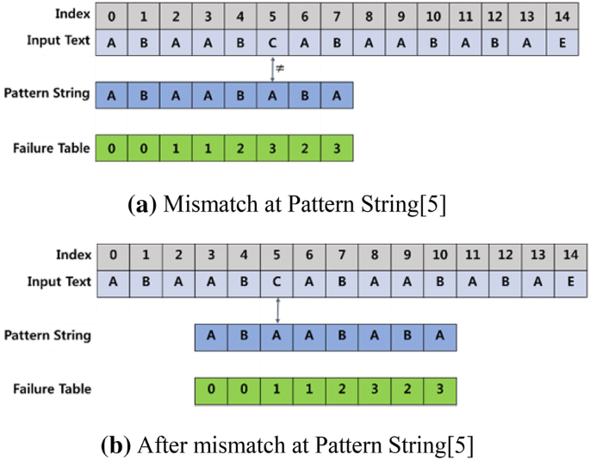
Knuth–Morris–Pratt Algorithm

Slide 7
KMP Algorithm:
KMP Algorithm is one of the most popular patterns matching algorithms. KMP stands for Knuth Morris Pratt. KMP algorithm was invented by Donald Knuth and Vaughan Pratt together and independently by James H Morris in the year 1970. In the year 1977, all the three jointly published KMP Algorithm.
KMP algorithm was the first linear time complexity algorithm for string matching.
KMP algorithm is used to find a "Pattern" in a "Text". This algorithm campares character by character from left to right. But whenever a mismatch occurs, it uses a preprocessed table called "Prefix Table" to skip characters comparison while matching. Some times prefix table is also known as LPS Table. Here LPS stands for "Longest proper Prefix which is also Suffix".

Slide 8
Steps for Creating LPS Table (Prefix Table):
Step 1 - Define a one dimensional array with the size equal to the length of the Pattern. (LPS[size])
Step 2 - Define variables i & j. Set i = 0, j = 1 and LPS[0] = 0.
Step 3 - Compare the characters at Pattern[i] and Pattern[j].
Step 4 - If both are matched then set LPS[j] = i+1 and increment both i & j values by one. Goto to Step 3.
Step 5 - If both are not matched then check the value of variable 'i'. If it is '0' then set LPS[j] = 0 and increment 'j' value by one, if it is not '0' then set i = LPS[i-1]. Goto Step 3.
Step 6 - Repeat above steps until all the values of LPS[] are filled.

Slide 9
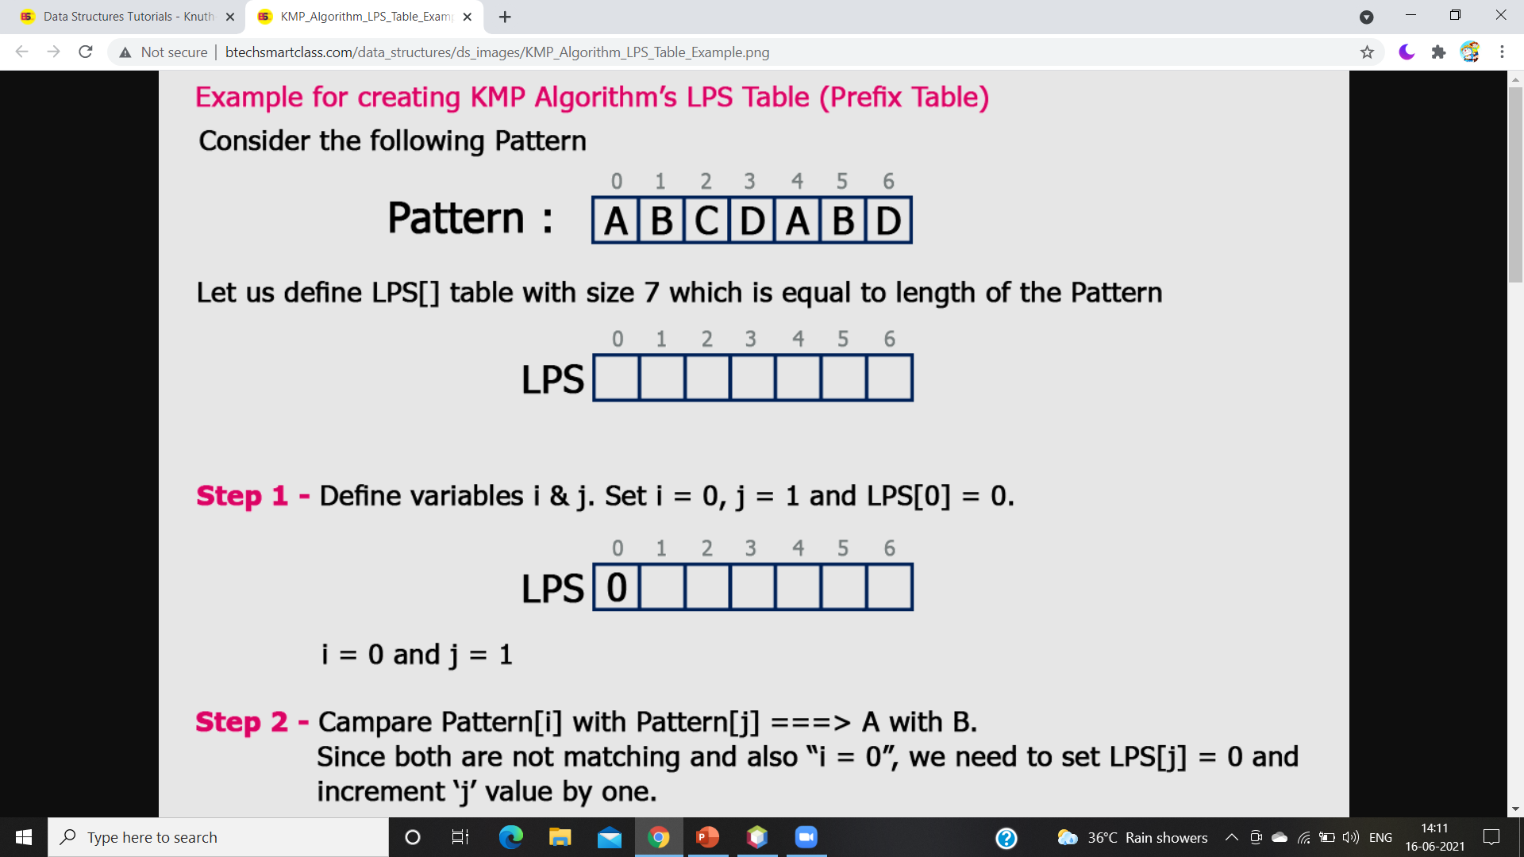
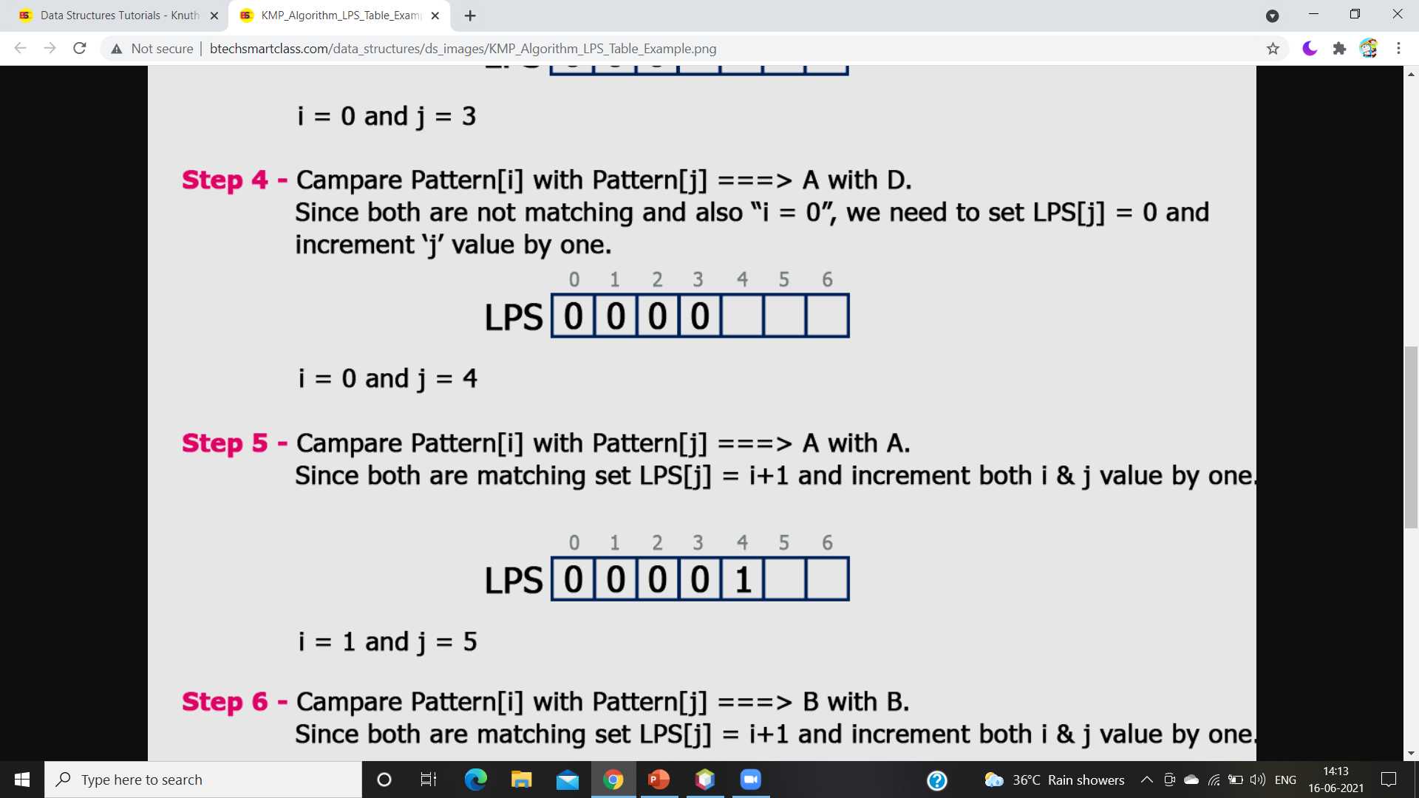
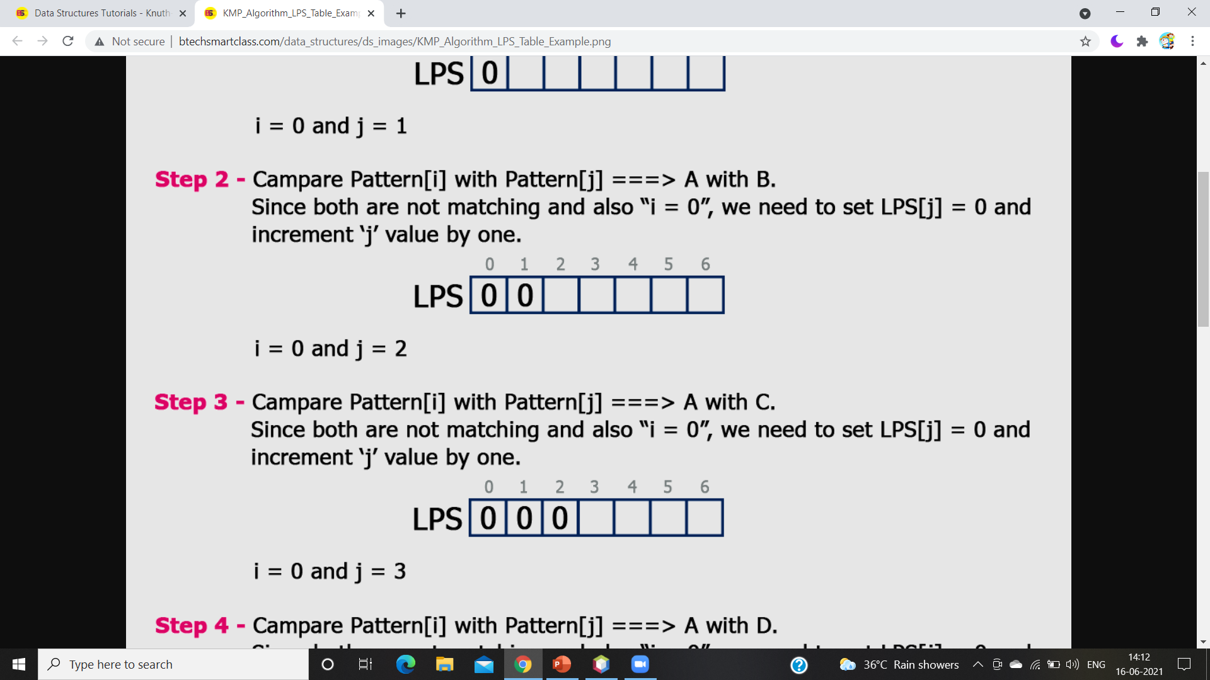
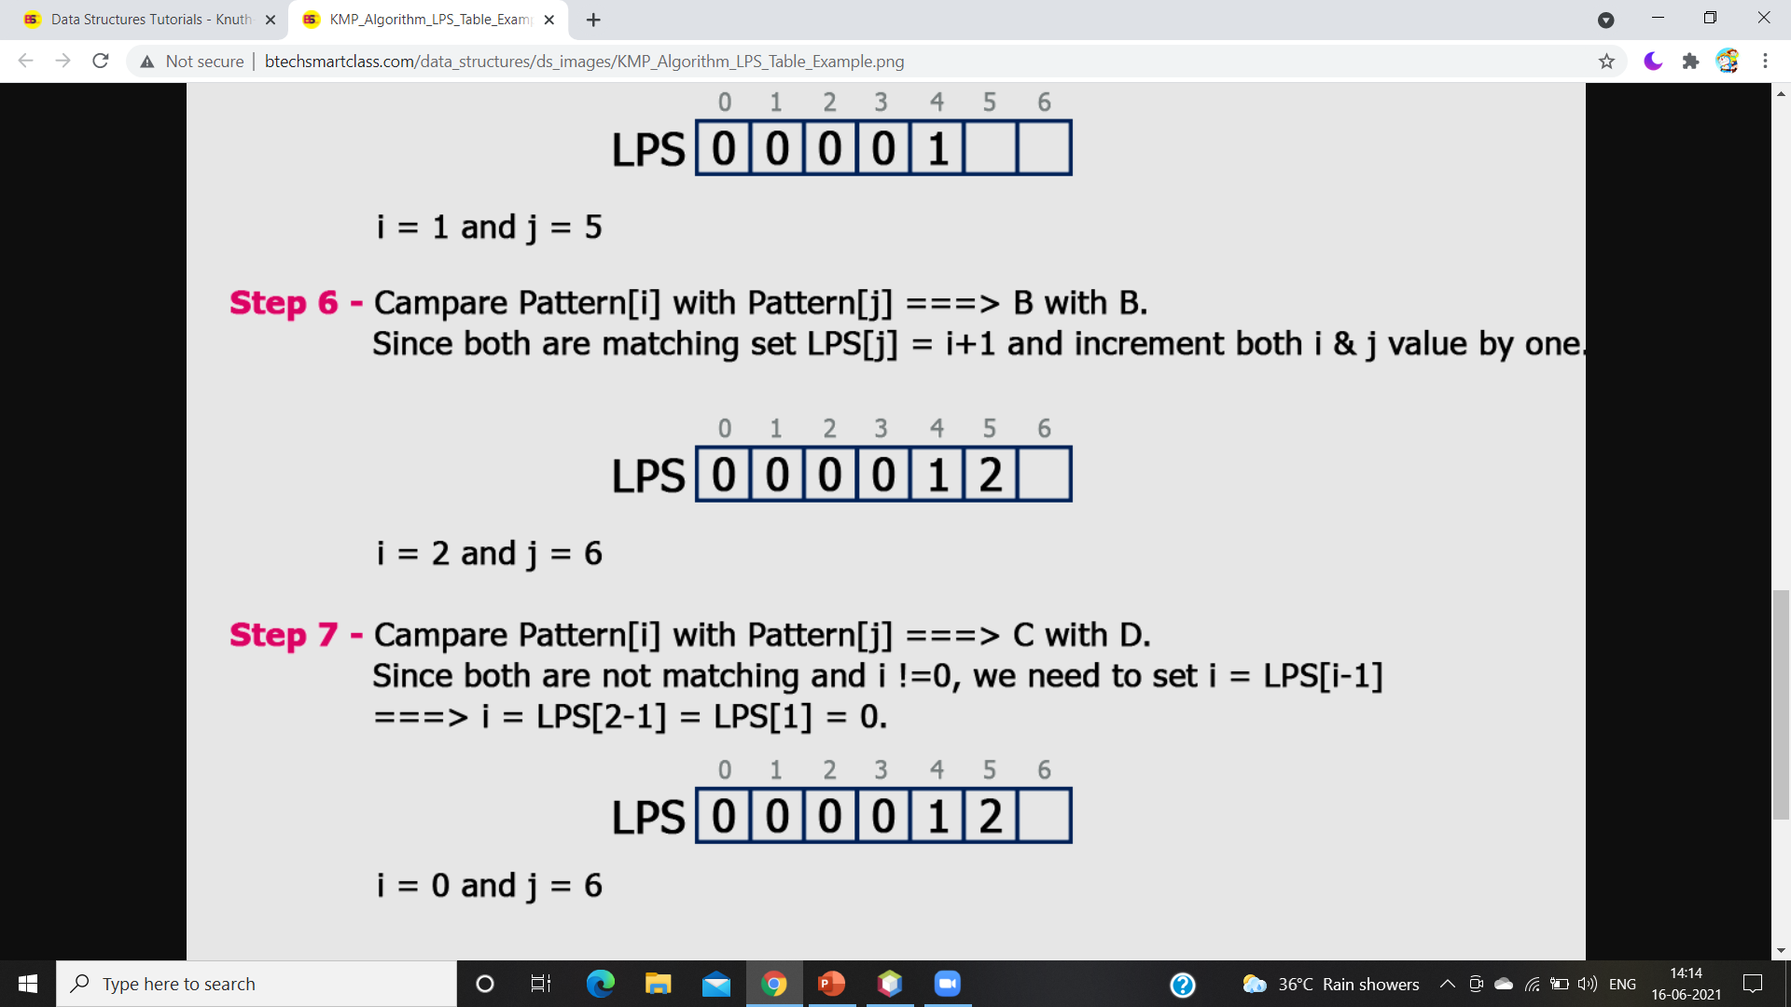

Slide 10
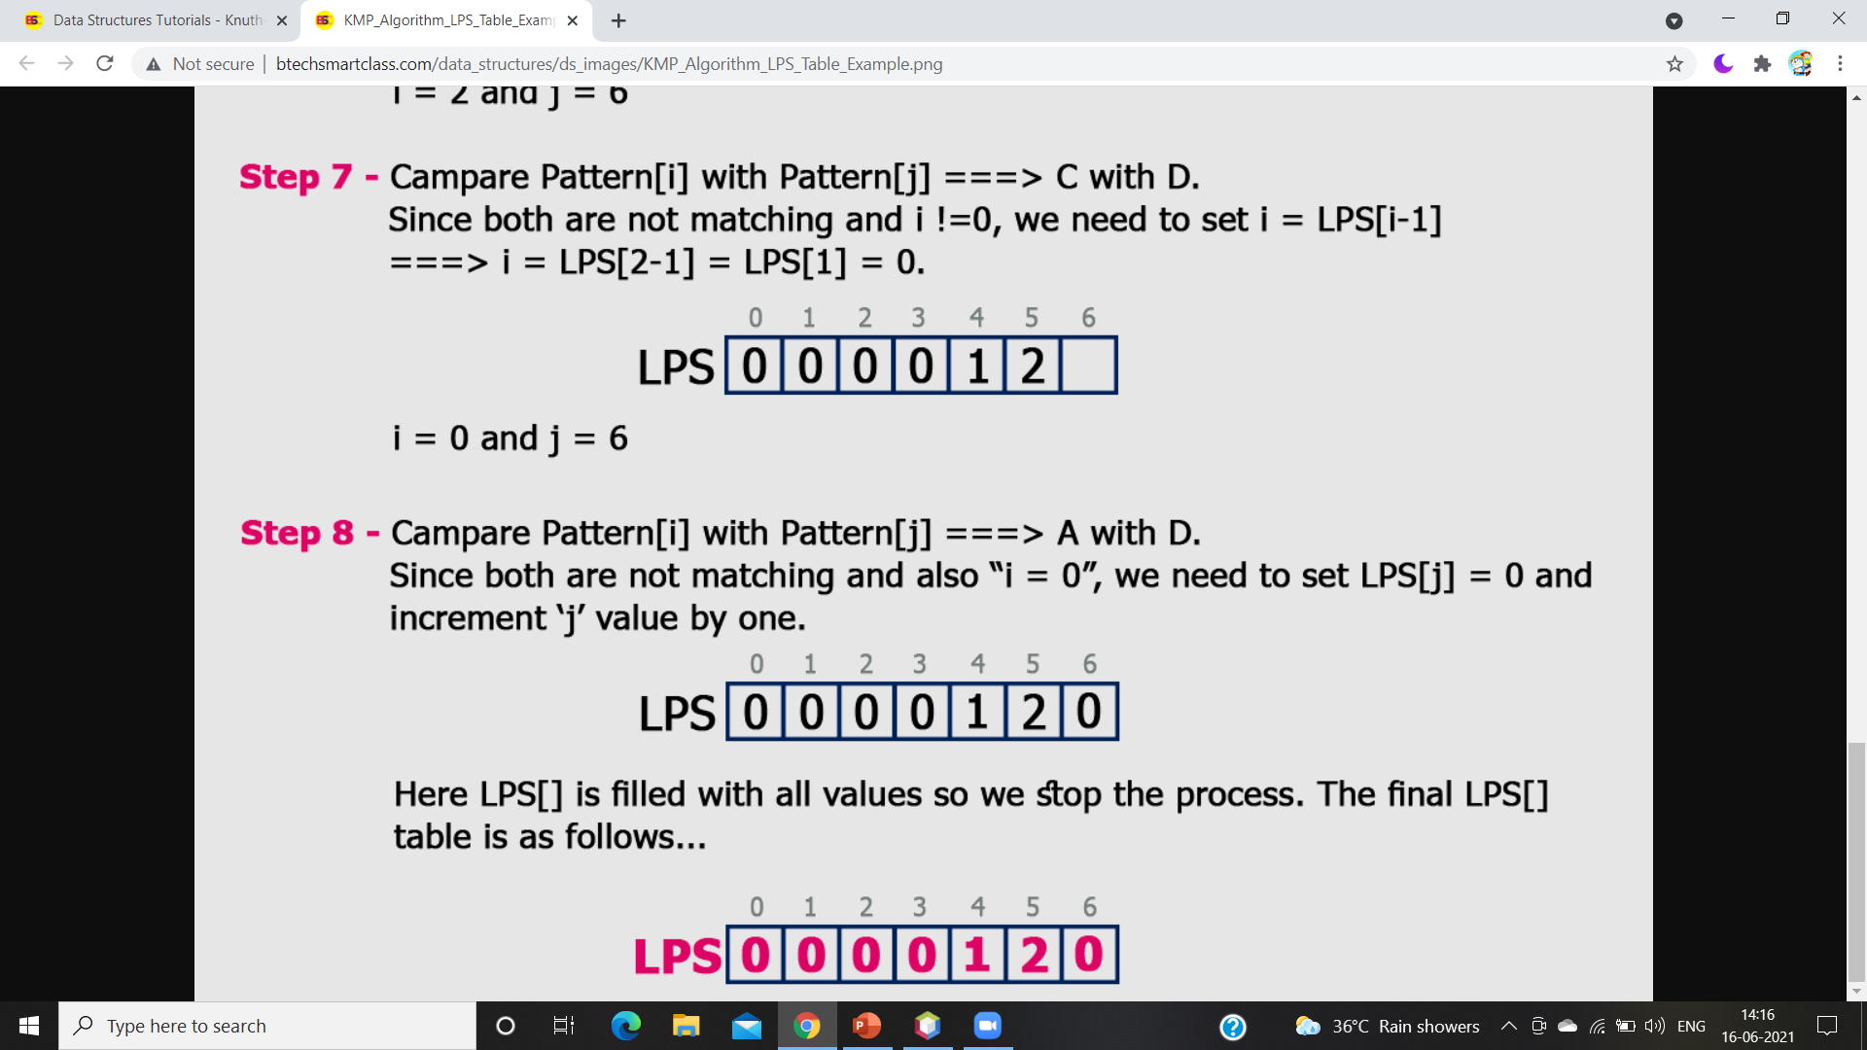

Slide 11
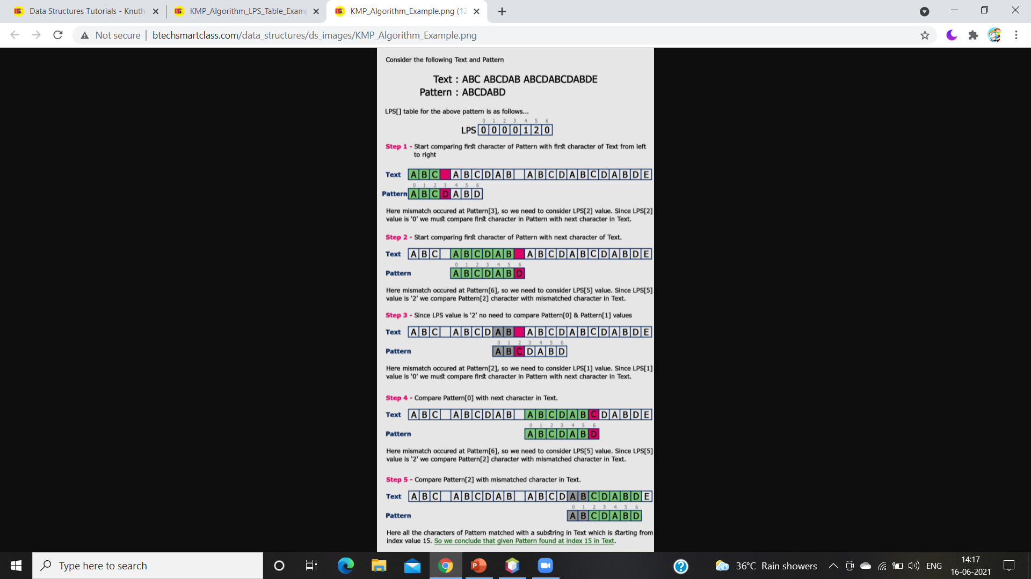

Slide 12
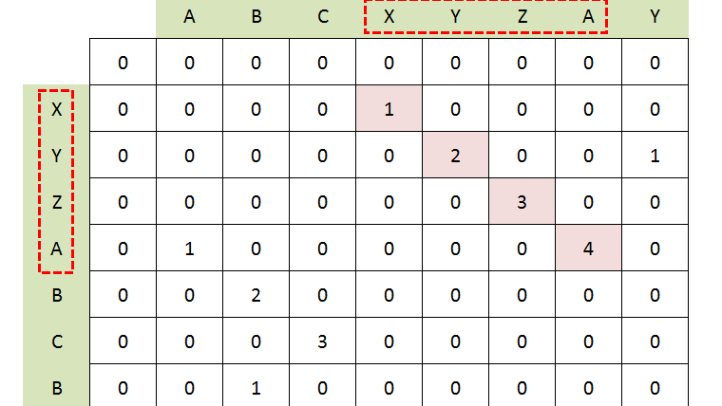
Longest Common Subsequence
Longest Common
Subsequence Algorithm

Slide 13
Longest Common Subsequence
The longest common subsequence problem is finding the longest sequence which exists in both the given strings.
If a set of sequences are given, the longest common subsequence problem is to find a common subsequence of all the sequences that is of maximal length.
Subsequence
Let us consider a sequence S = <s1, s2, s3, s4, …,sn>. A sequence Z = <z1, z2, z3, z4, …,zm> over S is called a subsequence of S, if and only if it can be derived from S deletion of some elements.
Common Subsequence
Suppose, X and Y are two sequences over a finite set of elements. We can say that Z is a common subsequence of X and Y, if Z is a subsequence of both X and Y.

Slide 14
Longest Common Subsequence Algorithm:
Algorithm: LCS-Length-Table-Formulation (X, Y)
m := length(X)
n := length(Y)
for i = 1 to m do
C[i, 0] := 0
for j = 1 to n do
C[0, j] := 0
for i = 1 to m do
for j = 1 to n do
if x = yj
C[i, j] := C[i - 1, j - 1] + 1
B[i, j] := ‘D’
else
if C[i -1, j] ≥ C[i, j -1]
C[i, j] := C[i - 1, j] + 1
B[i, j] := ‘U’
else
C[i, j] := C[i, j - 1]
B[i, j] := ‘L’
return C and B

Slide 15
Algorithm: Print-LCS (B, X, i, j)
if i = 0 and j = 0
return
if B[i, j] = ‘D’
Print-LCS(B, X, i-1, j-1)
Print(xi)
else if B[i, j] = ‘U’
Print-LCS(B, X, i-1, j)
else
Print-LCS(B, X, i, j-1)
This algorithm will print the longest common subsequence of X and Y
Analysis
To populate the table, the outer for loop iterates m times and the inner for loop iterates n times. Hence, the complexity of the algorithm is O(m, n), where m and n are the length of two strings.

Slide 16
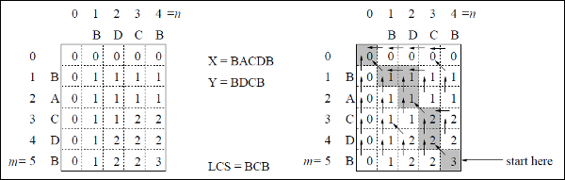
In this example, we have two strings X = BACDB and Y = BDCB to find the longest common subsequence.
Following the algorithm LCS-Length-Table-Formulation, we have calculated table C (shown on the left hand side) and table B (shown on the right hand side).
In table B, instead of ‘D’, ‘L’ and ‘U’, we are using the diagonal arrow, left arrow and up arrow, respectively. After generating table B, the LCS is determined by function LCS-Print. The result is BCB.

Slide 17
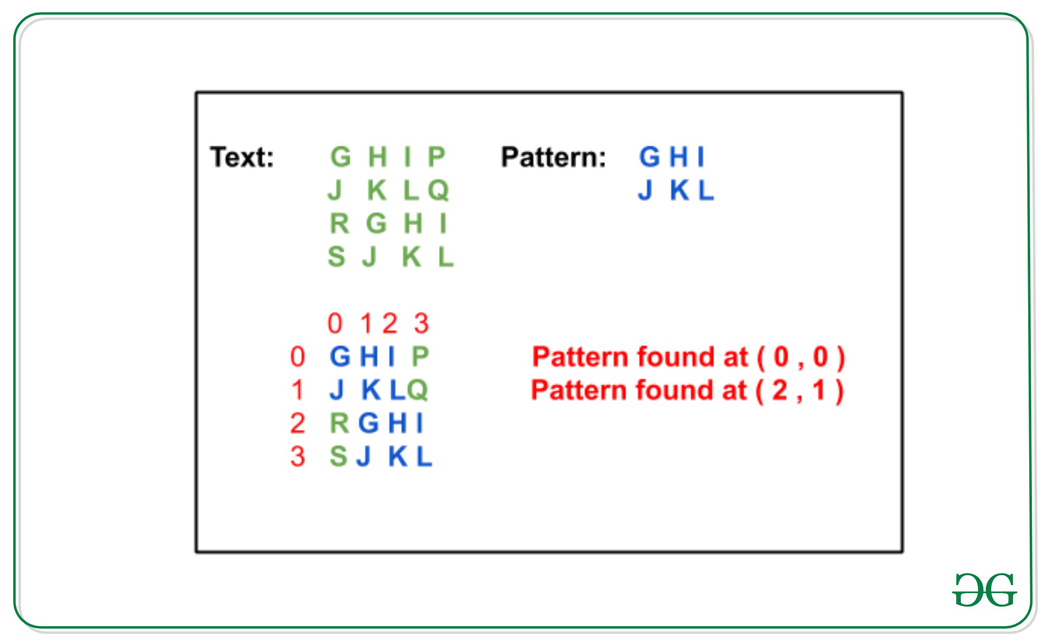
Rabin-Karp Algorithm
Infographic Style
The Rabin-Karp string searching algorithm uses a hash function to speed up the search.
If the hash values are unequal, the algorithm will calculate the hash value for next M-character sequence.
If the hash values are equal, the algorithm will do a Brute Force comparison between the pattern and the M-character sequence.
In this way, there is only one comparison per text subsequence, and Brute Force is only needed when hash values match.

Slide 18
Rabin-Karp Algorithm:
Begin
patLen := pattern Length
strLen := string Length
patHash := 0 and strHash := 0, h := 1
maxChar := total number of characters in character set
for index i of all character in pattern, do
h := (h*maxChar) mod prime
done
for all character index i of pattern, do
patHash := (maxChar*patHash + pattern[i]) mod prime
strHash := (maxChar*strHash + text[i]) mod prime
done

Slide 19
for i := 0 to (strLen - patLen), do
if patHash = strHash, then
for charIndex := 0 to patLen -1, do
if text[i+charIndex] ≠ pattern[charIndex], then
break the loop
done
if charIndex = patLen, then
print the location i as pattern found at i position.
if i < (strLen - patLen), then
strHash := (maxChar*(strHash – text[i]*h)+text[i+patLen]) mod prime, then
if strHash < 0, then
strHash := strHash + prime
done
End

Slide 20
Which Algorithm is best?
KMP Algorithm
01
Time Complexity:
O(n)
Lonest Common Subsequence
Rabin – Karp Fingerprint Algorithm
03
02
Time Complexity:
O(n * m)
Time Complexity:
O(n + m)

Slide 21
Requirements:
Software Requirements:
Java JDK 11 and higher
NetBeans 12.1 LTS
Hardware Requirements:
Memory: 2GB
Disk Space: 120MB
Processor: Intel(R) Core(TM) i5-10300H CPU 2.50 GHz
Function Requirements:
To detect plagiarism.

Slide 22
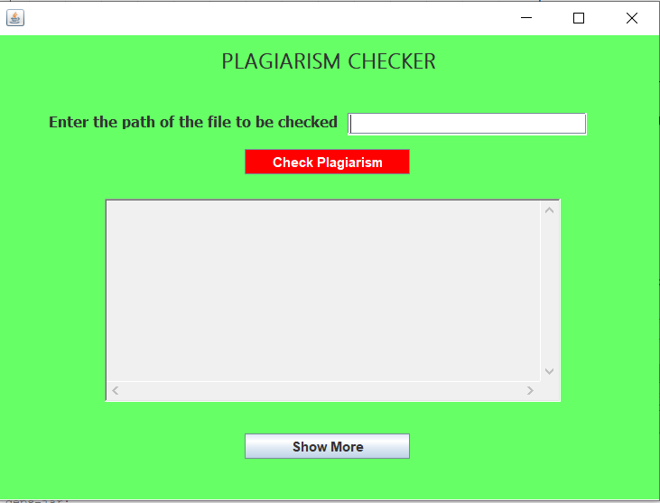
Screenshots:

Slide 23
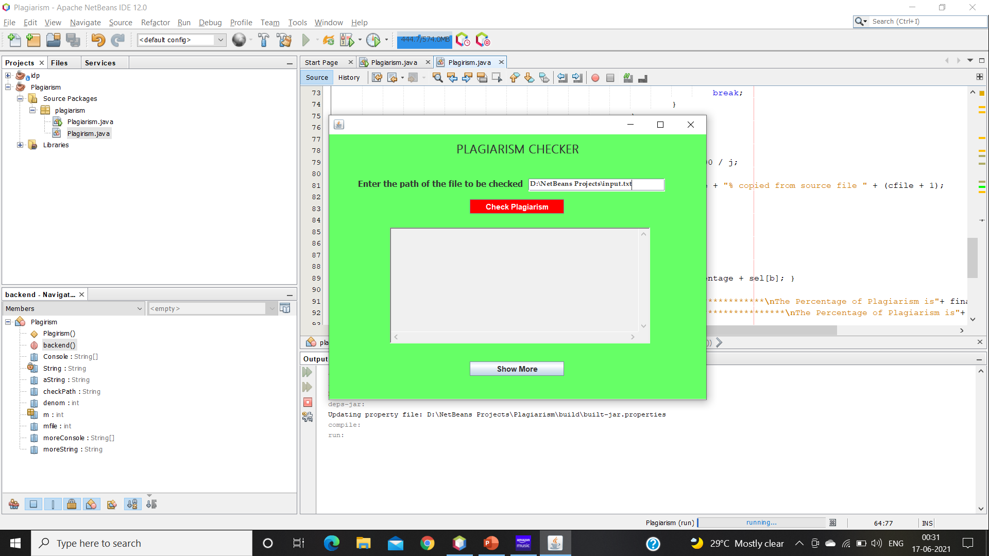
Enter the path of the file which need to plagiarize:

Slide 24
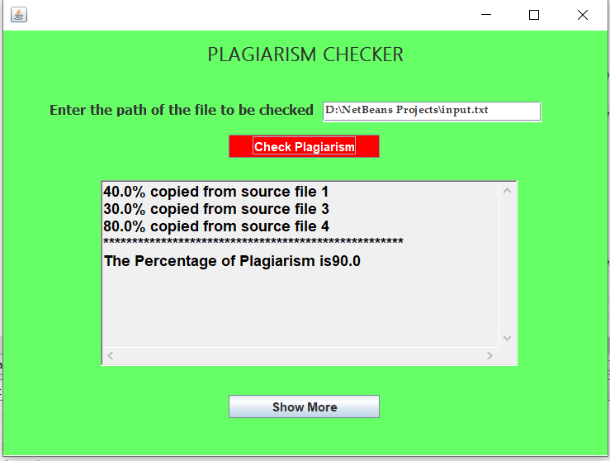
Output:

Slide 25
Conclusion:
In this way we can detect the plagiarised content among multiple text files using KMP Algorithm.

Slide 26
THANK YOU

